Slide 1
Saffron Natural Intelligence Platform NAVAIR – 1 Day Training
November 15th, 2017

Slide 2

AGENDA
Conceptual Review of Saffron
Creating Connections
Unstructured Data
Tool Box
Saffron Admin
REST API
Saffron Advantage
Thought Processes
Questions?
A presentation for
By
Cameron Byrd
Atul Borkar

Slide 3
Conceptual Review of Saffron
Notes:
Review key points already covered in the videos

Slide 4
Cognitive Computing – A definition
The theory and development of computer systems able to perform tasks that normally require human intelligence and therefore must be more human and brain-like:
Learning from varied data types – machines, humans, structured, unstructured
Adapting automatically as new data arrives
Reasoning from contextual patterns – e.g. connections, similarities – instead of models and rules
Recommending, prescribing what to do next using knowledge of experience
Performing at scale as big data becomes bigger
Saffron Natural Intelligence Platform
Notes:
If it requires human intelligence then systems must be more human and brain like
All of these requirements come together to make a cognitive platform
Human like means
Learning from everything including other things that learn or from the experience of others
Adapting with new information
Reasoning naturally from patterns –using learning – a simple example – touch a hot burner once learn – approach a hot object learning from the hot burner is applied automatically
Recommending, prescribing what to do – where have I see this before, what happened was it good bad – should I do it again, or how should I do it.

Slide 5

HOW saffron WORKS – the 4cs
Connections, Counts, Context and Closeness
Saffron unifies data sources, by connecting people, places, things, events at the entity level
Saffron also counts the frequency of the connections between entities in context of who, what, when, where, and why
Saffron continuously learns the context in which three objects are connected as new data arrives
Saffron measures the closeness of the similarity between objects based on the context of the question or problem

Slide 6









WHAT IT DOES
UNIFIES
Unify data from disparate sources at the entity level. See how people, places and things are connected
LEARNS
Learn continuously from raw data and adapt when context changes
ILLUMINATES
See emerging, converging and repeating patterns as data arrives, in real time

Slide 7
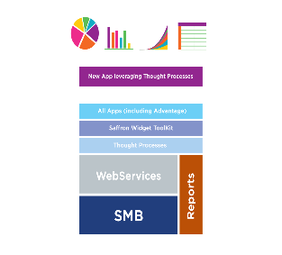

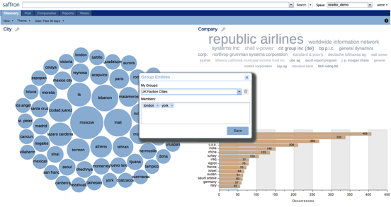
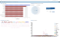
Saffron Data Flow
Rest API
Knowledge Feeder
Rest API
Knowledge Extractor
Solution NLP
Client Visualizations
Data 1
Saffron Parsers
Saffron Source Connectors/Interpreter
SMB
Data 2
Thought Processes
Saffron Visualizations
NLP
Data
Source
Connectors
Entity
Extractors
Applications, OS, Names
People, Dates, Severity, etc.
Patterns, Similarities, Anomalies, Sequences, Counts, Connections, Context, Closeness
Strength-Based Network Analysis
Event-based Similarity Detection
Classification
Temporal Similarity Analysis

Slide 8
CREATING CONNECTIONS

Slide 9
Incremental Learning
1
4
ID | NAME | DATE | RESTAURANT | LOCATION | COMPANION
120 | Jim | 06/02 | NeoMonde | Cary | None
ID.120 |  | 1 | 1 | 1 | 1 | 1
Name.Jim | 1 |  | 1 | 1 | 1 | 1
Date.06/02 | 1 | 1 |  | 1 | 1 | 1
Restaurant.NeoMonde | 1 | 1 | 1 |  | 1 | 1
Location.Cary | 1 | 1 | 1 | 1 |  | 1
Companion.None | 1 | 1 | 1 | 1 | 1
 | ID120 | Name.Jim | Date.06/02 | Restaurant.NeoMonde | Location.Cary | Companion.None
2
3
4
1
1
Record (Resource reference)
2
Category
3
Value
4
Attribute = Category:Value
5
Matrix of Row & Column Attributes,
with Connection Counts at the intersections
5
Notes:
We start with data source that we would like to ingest into Saffron, for example a table in SQL database, consisting of records (resource references).
As each row of such database data source is ingested, a column name gets represented as a “Category” coupled with its “Value” in each row.
Resulting combination of “Category” and “Value” is called an “Attribute” and is individually stored in Saffron’s associative memory.
In provided example, 6 attributes will be generated, each one being described by its category:value combination.
According to original database record 120, Jim ate alone at Neomonde in Cary on 6/2.
Translated to Saffron’s associative memory and taking into account 6 generated attributes, narrative becomes: (ID:120), (Name:Jim) ate with (Companion:none) at (Restaurant:Neomonde) at (Location:Cary) on (Date:June 2nd).
Arranging resulting 6 attributes as “Row Attributes” and “Column Attributes”, we can create a matrix or “Associative Memory” of mutual connections where intersection represents the count of interactions detected so far.

Slide 10
Incremental Learning – Add 2nd resource reference
2
ID | NAME | DATE | RESTAURANT | LOCATION | COMPANION
120 | Jim | 06/02 | NeoMonde | Cary | None
121 | Tom | 06/02 | NeoMonde | Cary | Mary
ID.120 |  |  | 1 |  | 1 | 1 | 1 | 1
ID.121 |  |  |  | 1 | 1 | 1 | 1 |  | 1
Name.Jim | 1 |  |  |  | 1 | 1 | 1 | 1
Name.Tom |  | 1 |  |  | 1 | 1 | 1 |  | 1
Date.06/02 | 1 | 1 | 1 | 1 |  | 2 | 2 | 1 | 1
Restaurant.NeoMonde | 1 | 1 | 1 | 1 | 2 |  | 2 | 1 | 1
Location.Cary | 1 | 1 | 1 | 1 | 2 | 2 |  | 1 | 1
Companion.None | 1 |  | 1 |  | 1 | 1 | 1
Companion.Mary |  | 1 |  | 1 | 1 | 1 | 1
 | ID120 | ID.121 | Name.Jim | Name.Tom | Date.06/02 | Restaurant.NeoMonde | Location.Cary | Companion.None | Companion.Mary
New row attributes
New record
Incremented counts
for existing
intersections of row and column attributes
New column attributes
Notes:
We ingest and process a new database record by breaking it again into attributes (i.e. category:value combinations), that we subsequently add to Saffron’s associative memory matrix.
Some of the attributes we’ve already encountered: (Restaurant:Neomonde), (Date:6/2) and (Location:Cary), but some of them are new: (ID:121), (Name:Tom), (Companion:Mary). We’ll show newly created attributes in orange.
Notice that only newly created attributes in orange are added to associative memory as new rows and columns. For existing attributes, we only increase corresponding counts on intersections (noted in black surrounded by green)

Slide 11
Incremental Learning – Add 3rd Resource Reference
3
ID | NAME | DATE | RESTAURANT | LOCATION | COMPANION
120 | Jim | 06/02 | NeoMonde | Cary | None
121 | Tom | 06/02 | NeoMonde | Cary | Mary
122 | Jim | 06/04 | Tower | Cary | Susan
ID.120 |  |  |  | 1 |  | 1 |  | 1 |  | 1 | 1
ID.121 |  |  |  |  | 1 | 1 |  | 1 |  | 1 |  | 1
ID:122 |  |  |  | 1 |  |  | 1 |  | 1 | 1 |  |  | 1
Name.Jim | 1 |  | 1 |  |  | 1 | 1 | 1 | 1 | 2 | 1 |  | 1
Name.Tom |  | 1 |  |  |  | 1 |  | 1 |  | 1 |  | 1
Date.06/02 | 1 | 1 |  | 1 | 1 |  |  | 2 |  | 2 | 1 | 1
Date.06/04 |  |  | 1 | 1 |  |  |  |  | 1 | 1 |  |  | 1
Restaurant.NeoMonde | 1 | 1 |  | 1 | 1 | 2 |  |  |  | 2 | 1 | 1
Restaurant.Tower |  |  | 1 | 1 |  |  | 1 |  |  | 1 |  |  | 1
Location.Cary | 1 | 1 | 1 | 2 | 1 | 2 | 1 | 2 | 1 |  | 1 | 1 | 1
Companion.None | 1 |  |  | 1 |  | 1 |  | 1 |  | 1
Companion.Mary |  | 1 |  |  | 1 | 1 |  | 1 |  | 1
Companion.Susan |  |  | 1 | 1 |  |  | 1 |  | 1 | 1
 | ID120 | ID.121 | ID:122 | Name.Jim | Name.Tom | Date.06/02 | Date.06/04 | Restaurant.NeoMonde | Restaurant.Tower | Location.Cary | Companion.None | Companion.Mary | Copmanion.Susan
Directory Memory = Associative Memory matrix of ALL Records
6
6
Notes:
Finally, when Jim and Susan meet for lunch at the Tower restaurant on June 4th in Cary, we can again parse the generated record and extract additional 4 attributes: (ID:122), (Date:6/4), (Companion:Susan) and (Restaurant:Tower).
The new attributes are added to associative memory matrix as new row attributes and column attributes. The counts at intersections of existing attributes (Name:Jim) and (Location:Cary) are incremented.
This associative memory matrix is called a “directory memory” in Saffron-ese.

Slide 12
Incremental Learning
MEMORY BUILD for CATEGORIES NAME AND RESTAURANT
ID | NAME | DATE | RESTAURANT | LOCATION | COMPANION
120 | Jim | 06/02 | NeoMonde | Cary | None
ID.120 |  | 1 | 1 | 1 | 1
Date.06/02 | 1 |  | 1 | 1 | 1
Restaurant.NeoMonde | 1 | 1 |  | 1 | 1
Location.Cary | 1 | 1 | 1 |  | 1
Companion.None | 1 | 1 | 1 | 1
Name:Jim | ID120 | Date.06/02 | Restaurant.NeoMonde | Location.Cary | Companion.None
ID.120 |  | 1 | 1 | 1 | 1
Name.Jim | 1 |  | 1 | 1 | 1
Date.06/02 | 1 | 1 |  | 1 | 1
Location.Cary | 1 | 1 | 1 |  | 1
Companion.None | 1 | 1 | 1 | 1
Restaurant: NeoMonde | ID120 | Name.Jim | Date.06/02 | Location.Cary | Companion.None
Notes:
As previously indicated, multiple categories might be declared to be of type “memory” and Saffron will automatically create new attribute memories and increment relevant counts as new resource records are ingested and processed.

Slide 13
Incremental Learning – Add 2nd resource reference
MEMORY BUILD for CATEGORIES NAME AND RESTAURANT
2
ID | NAME | DATE | RESTAURANT | LOCATION | COMPANION
120 | Jim | 06/02 | NeoMonde | Cary | None
121 | Tom | 06/02 | NeoMonde | Cary | Mary
ID.120 |  |  | 1 |  | 1 | 1 | 1
ID.121 |  |  |  | 1 | 1 | 1 |  | 1
Name.Jim | 1 |  |  |  | 1 | 1 | 1
Name.Tom |  | 1 |  |  | 1 | 1 |  | 1
Date.06/02 | 1 | 1 | 1 | 1 |  | 2 | 1 | 1
Location.Cary | 1 | 1 | 1 | 1 | 2 |  | 1 | 1
Companion.None | 1 |  | 1 |  | 1 | 1
Companion.Mary |  | 1 |  | 1 | 1 | 1
Restaurant: NeoMonde | ID120 | ID.121 | Name.Jim | Name.Tom | Date.06/02 | Location.Cary | Companion.None | Companion.Mary
ID.120 |  | 1 | 1 | 1 | 1
Date.06/02 | 1 |  | 1 | 1 | 1
Restaurant.NeoMonde | 1 | 1 |  | 1 | 1
Location.Cary | 1 | 1 | 1 |  | 1
Companion.None | 1 | 1 | 1 | 1
Name:Jim | ID120 | Date.06/02 | Restaurant.NeoMonde | Location.Cary | Companion.None
ID.121 |  | 1 | 1 | 1 | 1
Date.06/02 | 1 |  | 1 | 1 | 1
Restaurant.NeoMonde | 1 | 1 |  | 1 | 1
Location.Cary | 1 | 1 | 1 |  | 1
Companion.Mary | 1 | 1 | 1 | 1
Name:Tom | ID121 | Date.06/02 | Restaurant.NeoMonde | Location.Cary | Companion.Mary
Notes:
As previously indicated, multiple categories might be declared to be of type “memory” and Saffron will automatically create new attribute memories and increment relevant counts as new resource records are ingested and processed.

Slide 14
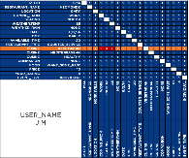

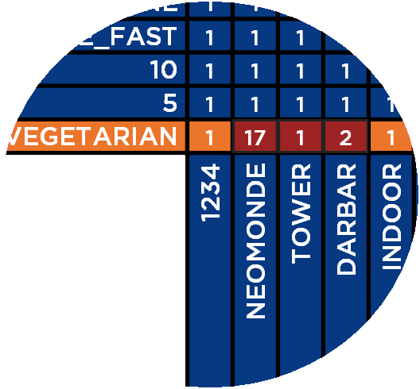
Scaled to Millions & Billions of Matrices
JIM MEMORY
VEGETARIAN MEMORY
A massive hypergraph of connections and correlations
14

Slide 15
UNSTRUCTURED DATA

Slide 16
Multiple Entity Matrices from Just One Snippet
Snippet of intelligence in RefID 1234
John Smith flew to London on 14 Jan 2009 aboard United Airlines to meet with the Prime Minister
for 2 hours on a rainy day.
Notes:
For every entity and other mark in the data…

Slide 17
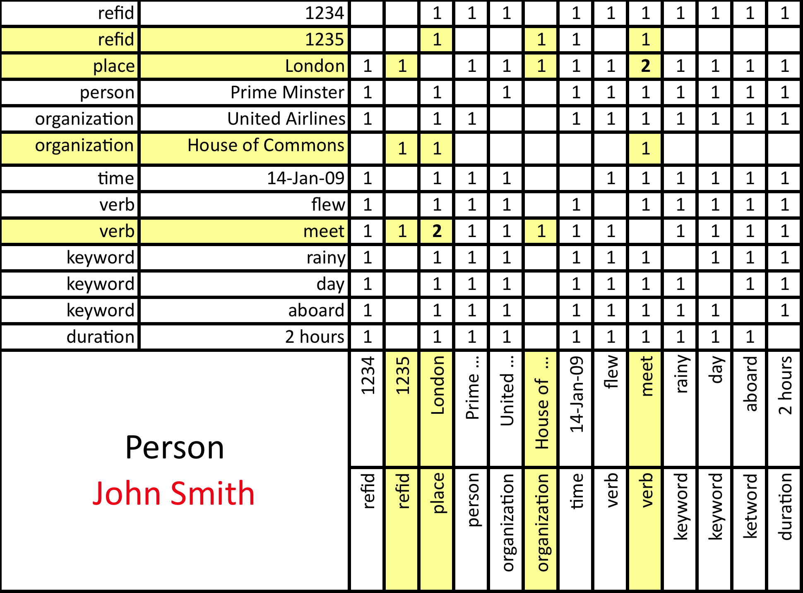
Incremental Update Observing Another Snippet
John Smith also met with the House of Commons while in London.
Notes:
Sentence by sentence, document by document, record by record, data base by data base, …

Slide 18
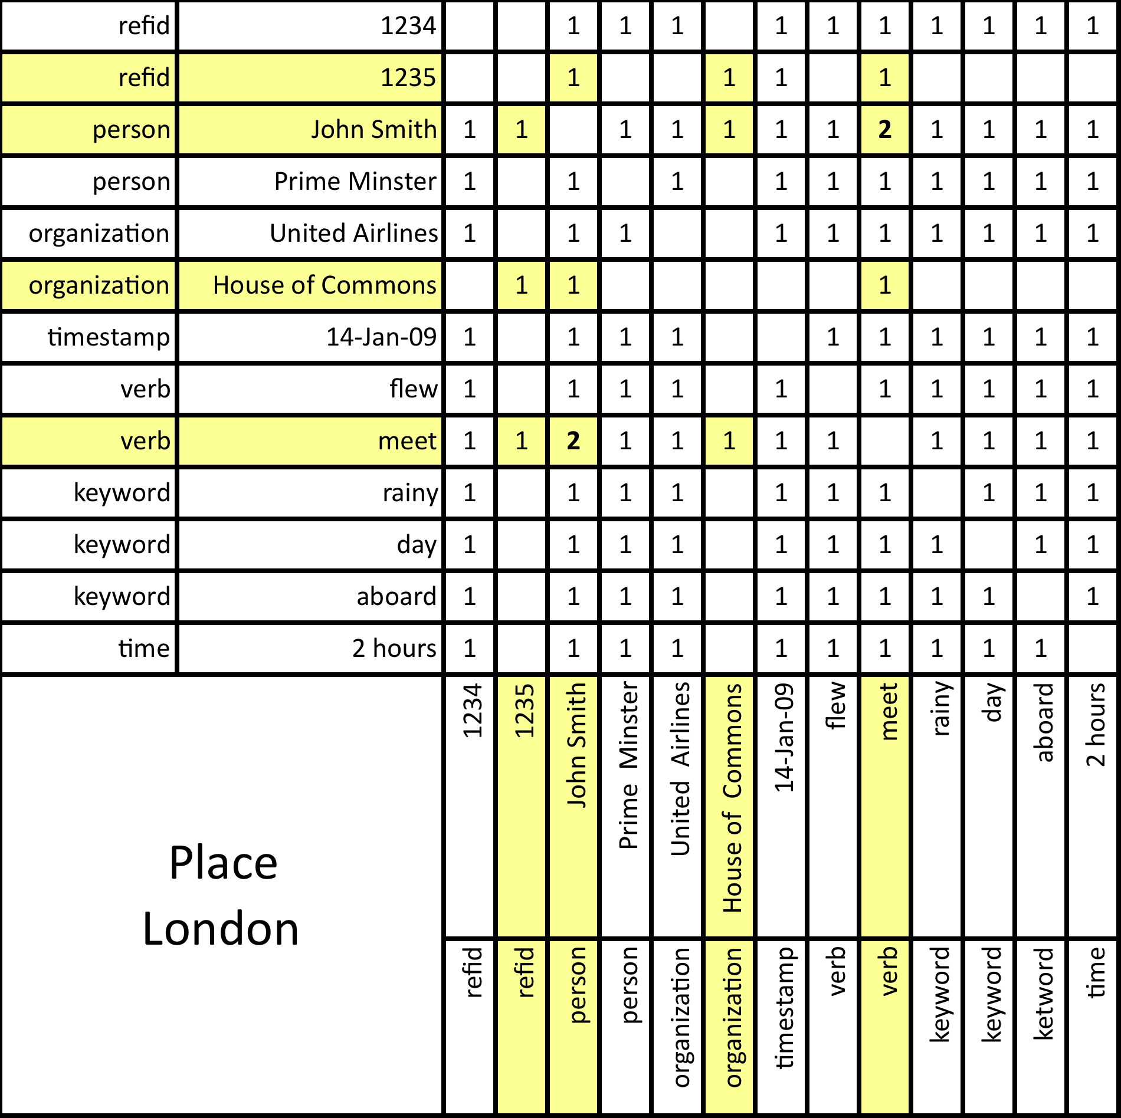
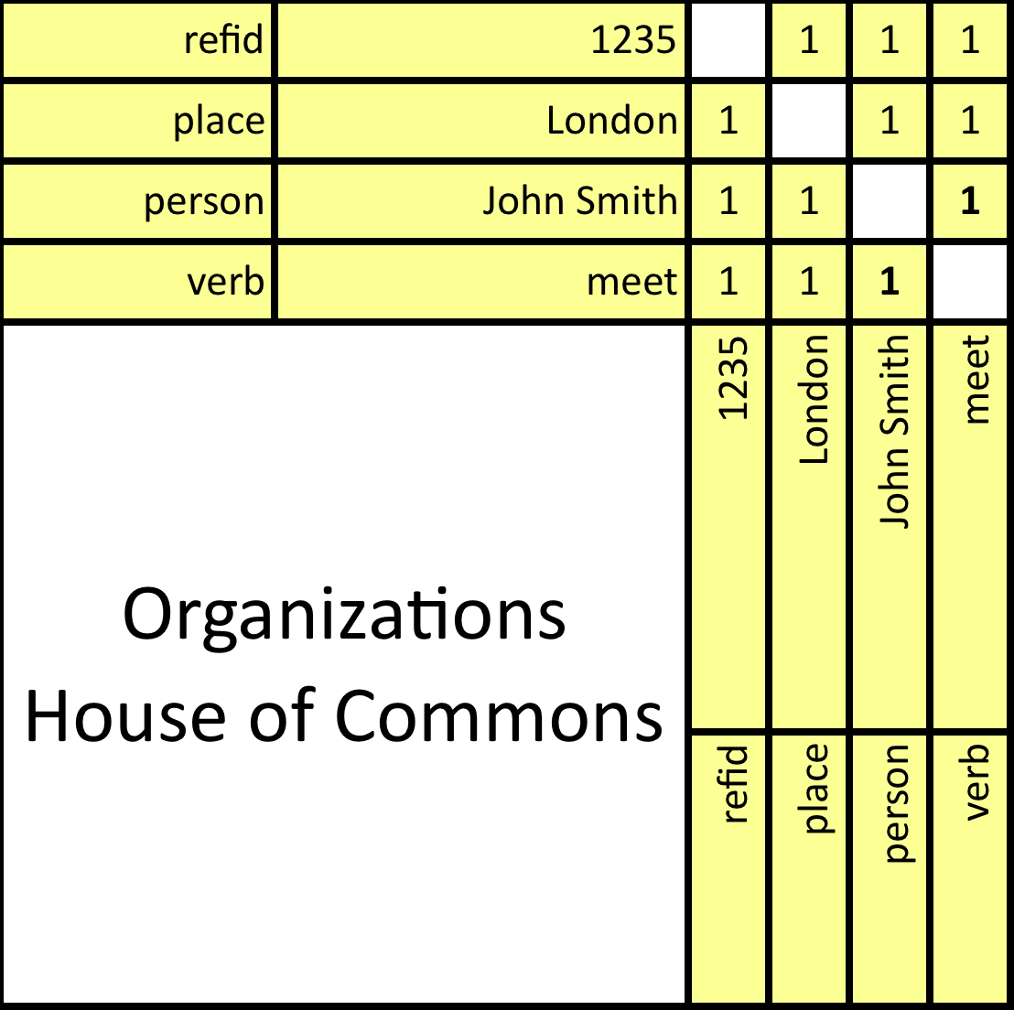
Incremental Update Observing Another Snippet
John Smith flew to London on 14 Jan 2009 aboard United Airlines to meet with the Prime Minister
for 2 hours on a rainy day.
John Smith also met with the House of Commons while in London.
No change
Notes:
For every THING in the data, including all context – at massive scale, not just these two sentences.
This is the way our brains work. I will meet some of you for the first time and know it is the first time.
I knows others of you very well, not just in strength, but in know who else, where, and what of when we’ve met before.
I might remember when we met on some particular topic, twice. Not the probability of meeting, a memory of meeting.

Slide 19
Break

Slide 20
Tool Box

Slide 21
Reasoning by Similarity
Applications:
Find Duplicates
Find Matching Entities
Find Previous Resolutions
Example:
Find PEs that are Similar to Other PEs
Cluster
Detect Anomalies and Similarities Between PEs
Notes:
Matching entity examples:
- Requisitions to Resumes
- Defect to Expert
Match on problem => show resolution of best match

Slide 22
Classification
Application :
Determine Interesting “Bucket(s)” for a Large Number of Instances Based on a Few Examples
Classic Supervised Learning
Works well with Unstructured Data
Predict Events
Example:
Automatic Event Triage
Hypoxia PE
Air Sickness PE

Slide 23
Recommender
Application:
Recommend the Next Action for a Given Situation.
Example:
Create Workflows and Action Plans
Given a Situation, is a PE Likely to Occur in the Near Future?
Notes:
Also, e.g. next movie as in Netflix

Slide 24
ROOT CAUSE ANALYSIS – NAVAIR Approach
Application:
Determine the Cause of an Event
Combines Elements of Similarity, Classification, and Recommender
Addition of Information Measures
Example:
What is Causing the PEs?
Notes:
Also, e.g. next movie as in Netflix

Slide 25
SAFFRON ADMIN

Slide 26
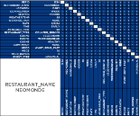
DATA INTEGRATION OVERVIEW
High-level goal: data transformation
Think “data flow diagram”
Given raw data (input) and desired output, create a flow to get from one form to the other
Specify parsers/filters to move data from native form to category:value pairs (attributes) which are mapped into SMB (memory, row, column, matrix)
Saffron Admin

Slide 27

Workflow for data ingestion
Create a Space
Create a Source
Entity Design
Test
Publish Space
Ingest Data

Slide 28
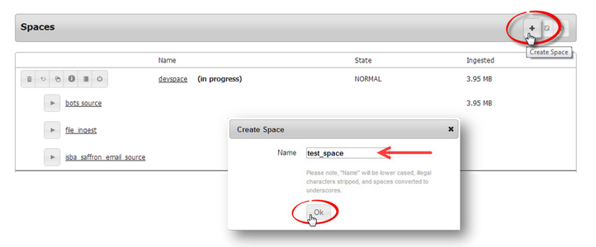
Create a space
The Spaces section on the Admin Dashboard is the starting point for data ingestion.
A Space is an application container that stores the ETL configuration for your specified data.
It stores the settings for your data ingestion.

Slide 29
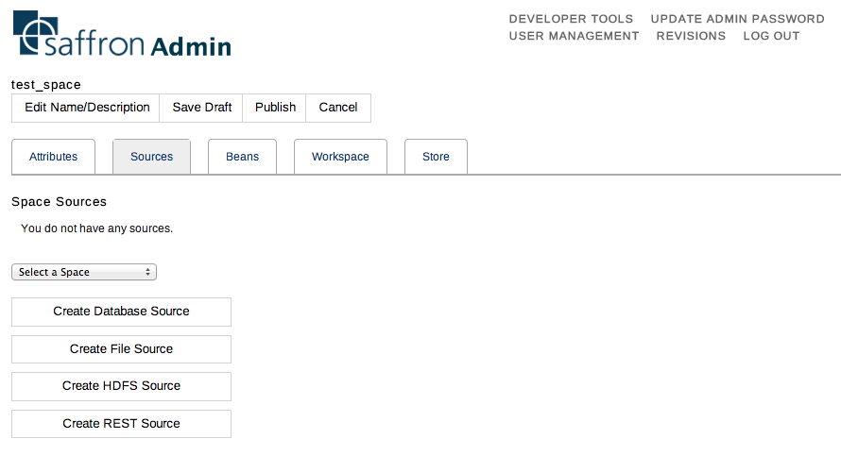
Create a source
Select a data source format

Slide 30
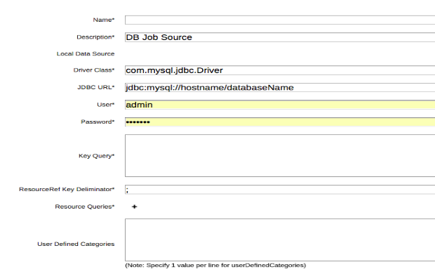
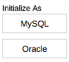
Ingesting MS sql Server Source
net.sourceforge.jtds.jdbc.Driver
jdbc:jtds:sqlserver://hostname;
databaseName=WOSBSP;
integratedSecurity=true;
authenticationScheme=JavaKerberos;
domain=amr
select DISTINCT buildid from testresults;
Resource queries acquire the data associated to the key value(s) that is used to build the resource.
select buildid, … from testresults where buildid = ${buildid};
Notes:
Driver Class : net.sourceforge.jtds.jdbc.Driver
Connection String : jdbc:jtds:sqlserver://WOSBSPSTAGING.amr.corp.intel.com;databaseName=WOSBSP;integratedSecurity=true;authenticationScheme=JavaKerberos;domain=amr;
Key Query : select DISTINCT buildid from testresults;
Resource query : select buildid from testresults where buildid = ${buildid};

Slide 31
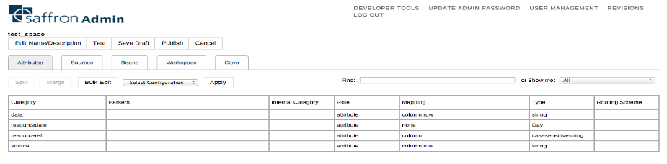
Attributes Tab
Once your data Source is created, you must specify what you want SMB to do with the created attributes.
Configuring attributes involves the following:
Define Data Parsers
Assign Roles
Assign Data Types
Define Data Mapping
Assign Routing Schemes (performance consideration only)

Slide 32
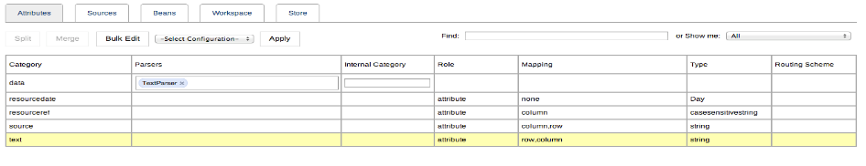
Data Parsers
Data Parsers are available for several file types
xls, xlsx, xml, csv, doc, txt, ppt, pdf, etc.
They tell the system how to read the data
They can be found under the beans tab

Slide 33
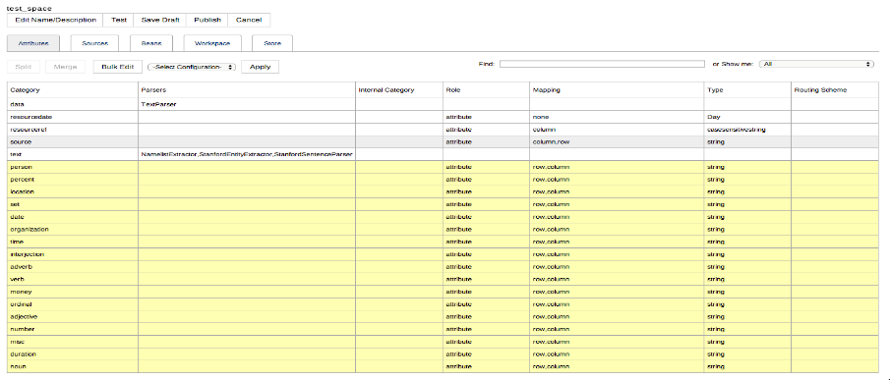
Text Parsing Example
StanfordEntityExtractor: NLP tool
StanfordSentenceParser: creates segments on a sentence boundary
Categories added from parsers

Slide 34
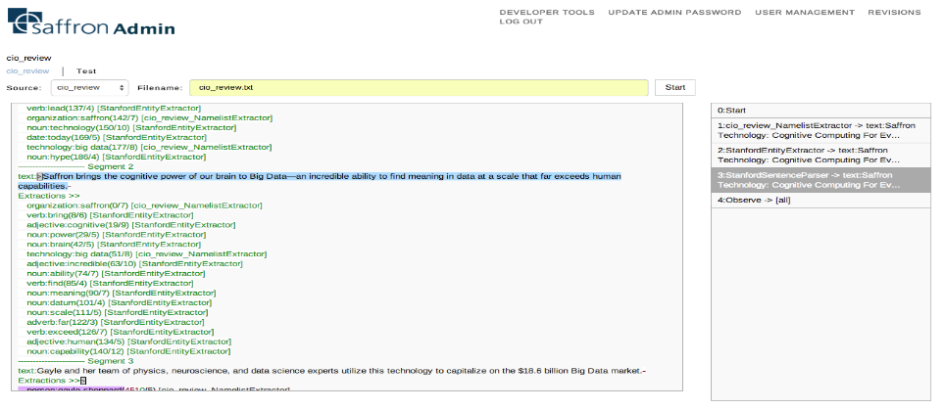
Test
Step through parse chain
Visualize segments and extractions

Slide 35
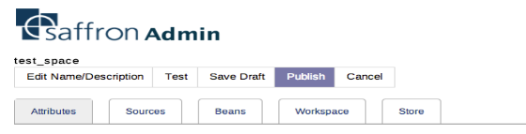
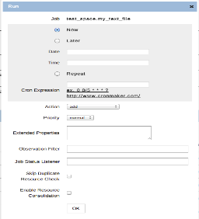
Publish and Ingest
Publish space when you are ready to ingest
Select the play button next to your source to run the ingestion
Action
Add: add associations from files in source definition to current ingestion
Remove: removes associations from files in source definition from current ingestion
Update: checks for new files
Select ok to run

Slide 36
Break

Slide 37
REST API

Slide 38





Sample of APIs for Analytic Reasoning
Connections - Knowing who and what with their frequencies and context, is connected to a consumer, a product, a brand, a location, and more in time and space.
Analogies – Finding similar people, places or things, association patterns, without modeling. Learns incrementally as patterns change.
Classifications – Making “experience based” decisions. Ranks and presents people, places or things in natural classifications based on nearest neighbor or hetero-associative match.
Trends – Associations that have the most change of timeframe. Valuable for sentiment, customer and employee social feedback as associated with products, management, business decisions, events.

Slide 39
CONNECTIONS

Slide 40
Connections API
Connections API finds all connections from attributes in the query to all other attributes
Query using AQL (q parameter)
Results can be ranked using several scoring metrics
Frequency, entropy, Kolmogorov (correlation), Shannon, etc.
Several parameters allowing you to:
Narrow your results by specifying output categories
which memory/memories to use/exclude
how to join the counts from multiple memories
time range to use/exclude
https://saffrontech.atlassian.net/wiki/display/DOC/Connections

Slide 41
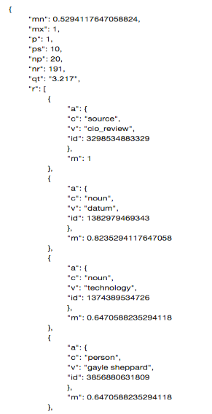
Connections call
connections?q=saffron
mn: minimum metric value across entire result set
mx: maximum metric value across entire result set
p: page that is being returned
ps: number of items per page/page size
np: total number of pages
nr: total number of results across all pages
qt: query time (seconds)
r: collection of results
a: attribute
c: category
v: value
id: unique id of attribute
m: metric: the normalized rollup metric of the result

Slide 42
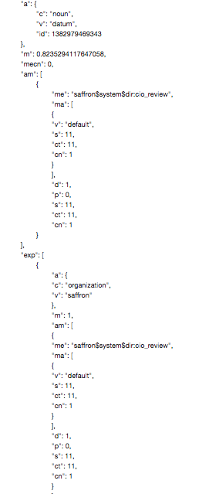
Connections API: advanced metric
ml=0
connections?q=saffron&ml=2
mecn: memory connections, the number of memories that were used to score the output
am: advanced metric
me: memory name
ma: matrix block
v: matrix name (default matrix holds all doubles)
s: score ( equals connections when sm=0)
ct: count- sum of the association counts of the input attributes
(query terms) to any given output attribute (result).
cn: connections- the number of input attributes (query terms)
that are connected to output attributes (result
d: distance- reflects the relevancy of the memory perspective.
The closer the distance, the more relevant the memory. For
example, triple memories will have a distance of 0, while the
directory memory will have a distance of 1. Also takes into
distance from preferred time.
p: priority
s: total score
ct: total count
cn: total connections
exp: explanation- lists category:value pairs in query connected to
result

Slide 43
ANALOGIES

Slide 44
Analogies API: find similar attributes
Two Steps:
1. Gets best signature of your target attribute
Signature generation method: frequency/mutual information/correlation
Selects subset of connected attributes that best represent the target attribute
Provide list of signature categories
2. Goes to all other attributes in target attribute category, inputs the signature terms into each of their memories and returns similarity score
Define scoring metric (frequency, correlation, etc)

Slide 45
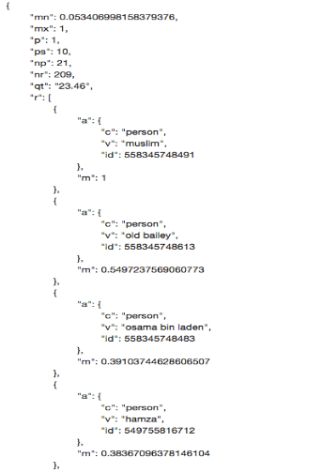
Analogies call
analogies?a=person:abu hamza
USE ANALOGIES TO:
-FIND SIGNATURE OF ATTRIBUTE (si=true) or
-SIMILAR ENTITIES
mn: minimum metric value across entire result set
mx: maximum metric value across entire result set
p: page that is being returned
ps: number of items per page/page size
np: total number of pages
nr: total number of results across all pages
qt: query time (seconds)
r: collection of results
a: attribute
c: category
v: value
id: unique id of attribute
m: metric: the normalized rollup metric of the result

Slide 46
CLASSIFICATION

Slide 47
Classification API
Use to return a rank-ordered list of classifications associated to query
spam/not spam
malignant/benign
edible/poisonous
Various scoring methods:
frequency, nearest neighbor, etc.
Training set needed
Mushroom A
?
?
Edible
Poisonous

Slide 48
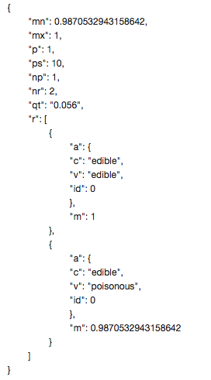
Classification call
classifications?q="veil-type":"partial" "veil-color":"white" "gill-attachment":"free"&c=edible
*USE ANALOGIES OR CONNECTIONS TO FIND SIGNATURE (si=true)
*input signature as q parameter
mn: minimum metric value across entire result set
mx: maximum metric value across entire result set
p: page that is being returned
ps: number of items per page/page size
np: total number of pages
nr: total number of results across all pages
qt: query time (seconds)
r: collection of results
a: attribute
c: category
v: value
id: unique id of attribute
m: metric: the normalized rollup metric of the result

Slide 49
Classification call
classifications?q="veil-type":"partial" "veil-color":"white" "gill-attachment":"free"&c=edible
-classification category must be a memory
-all other attributes don’t have to be memories, but attribute-to-attribute associations must be turned on
-classifications API does not use directory memory, goes to classification memories
edible:edible
edible:poisonous
veil-type:partial
veil-type:partial
veil-color:white
veil-color:white
gill-attachment:free
gill-attachment:free
score
score

Slide 50
TRENDS

Slide 51
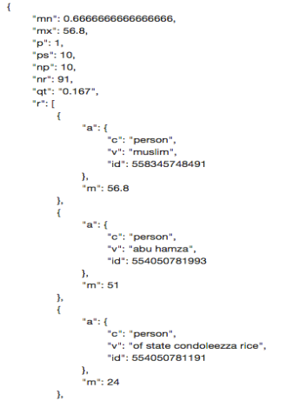
Trends API:
Returns rank order list of linear regression slope of connections to query terms over time
trends?q=city:london&c=person
mn: minimum metric value across entire result set
mx: maximum metric value across entire result set
p: page that is being returned
ps: number of items per page/page size
np: total number of pages
nr: total number of results across all pages
qt: query time (seconds)
r: collection of results
a: attribute
c: category
v: value
id: unique id of attribute
m: metric: slope of linear regression

Slide 52
ALGORITHMS

Slide 53
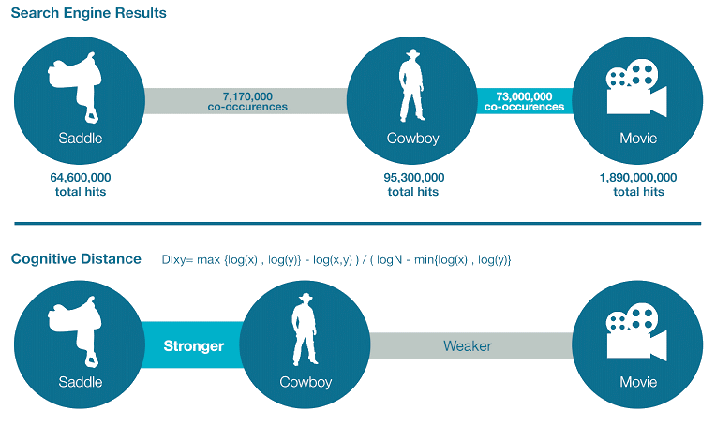
Problem with Raw Counts
Google search for frequencies
“cowboy”, “saddle”, “movie”, “cowboy saddle”, “cowboy movie”

Slide 54
Some BASIC Information Theory
1.89 Billion
Movie
Cowboy
95M
64M
Saddle
Cowboy
1.48 Times Larger
~20 Times Larger

Slide 55
Generalized Dependency As Cognitive Distance
Which is closer to cowboy? Saddle or movie?
Universal Information Distance
max {log(x),log(y)}-log(x,y) / ( logN-min{log(x),log(y)} )
Movie (73M) is much more frequently associated than saddle (8M)
But saddle (0.35) is cognitively closer than movie (0.47)

Slide 56
Break

Slide 57
SAFFRON ADVANTAGE

Slide 58
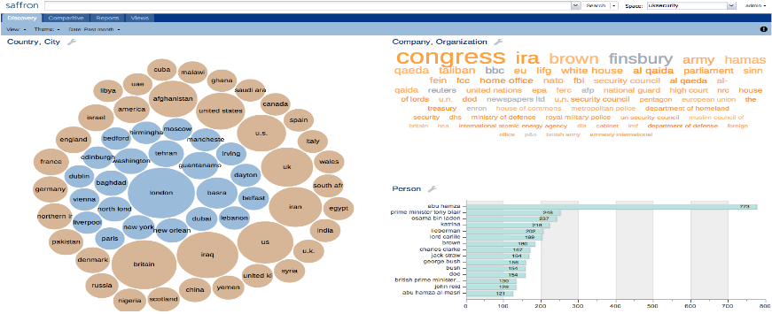
Dashboard: Overview
App. home
Common panel
Search expression
Select space
Select date range
Apply theme
Logout, help, unbury, about
Save query, page, category selection, theme and date in a View

Slide 59
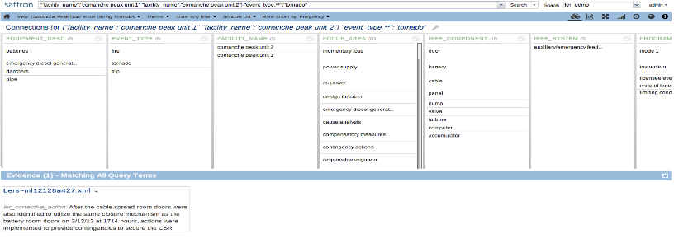
Query Views – Overview
Enter query views by using analytic menu or launching search
Common panel
Manage Views
Select time period
Select data source
Notification
Frequency/Correlation (subset)
Entity view
Map view
Apply Theme
Context view
Episode view
Network view
Trends view

Slide 60
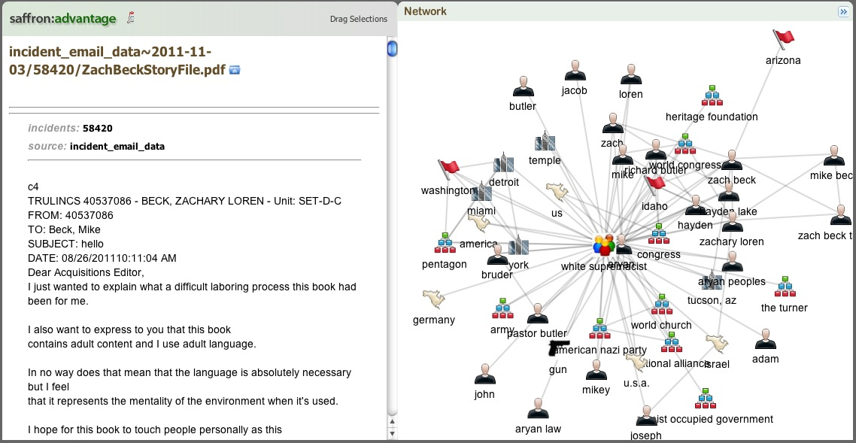
Query Views – Document Viewer
Click on evidence
Expand/collapse network panel
Document Id in system
Document text
Entity network for the document

Slide 61
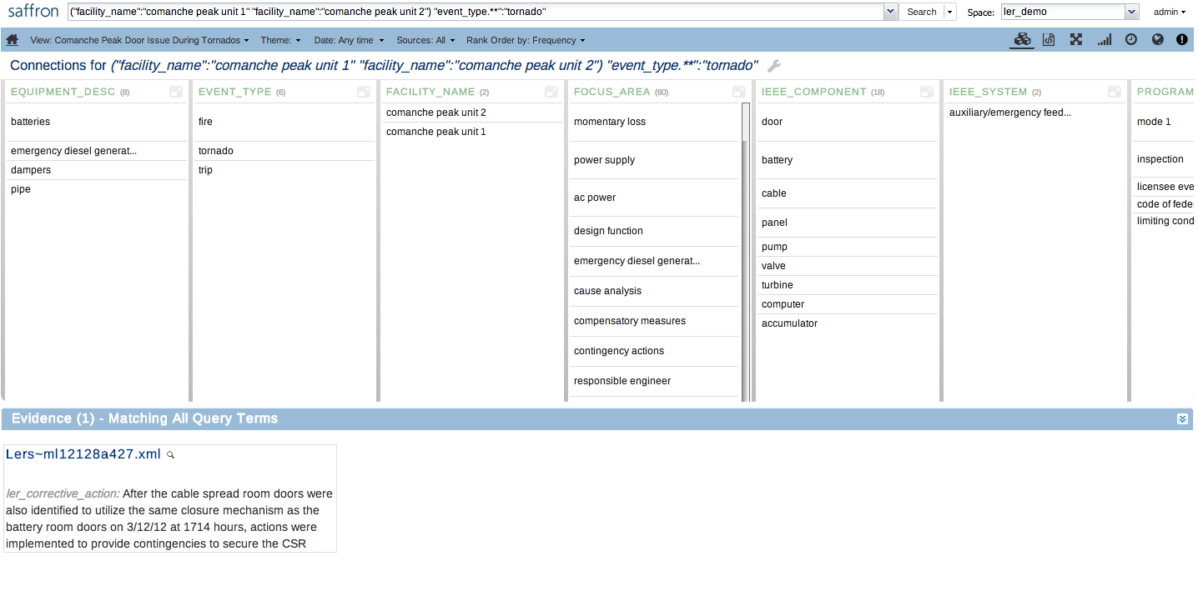
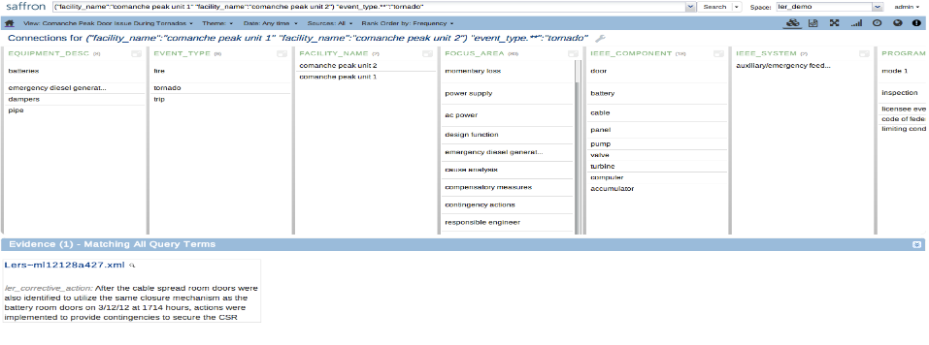
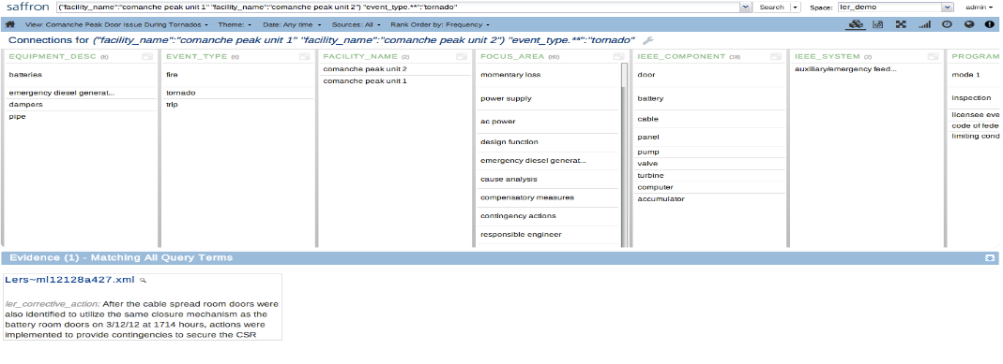
Query Views – Entity View
Entity View: find and rank associated entities to the input query.
Tip: use “empty query” to find out top entities.
Entity categories
Category Selector
By default, entities appear alphabetical left to right by column category
more
Support evidence

Slide 62
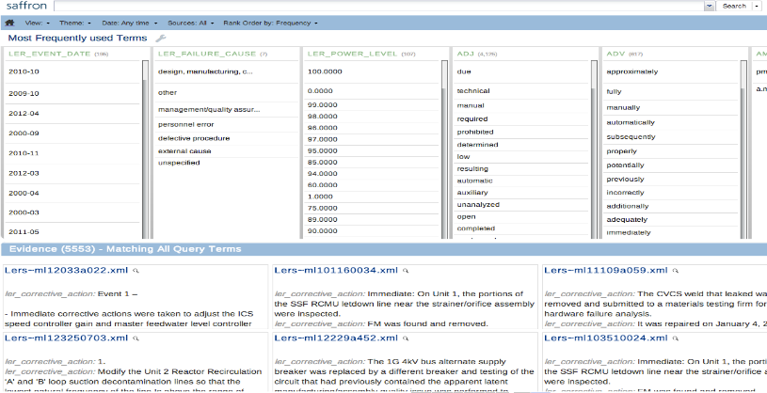
Query Views – Context View
Context View: find and rank associated attributes to the input query.
Attribute categories
Attributes appear alphabetical left to right by column category
Keywords are examples of terms that don’t justify their own memory, but add context to an association between two memories.

Slide 63
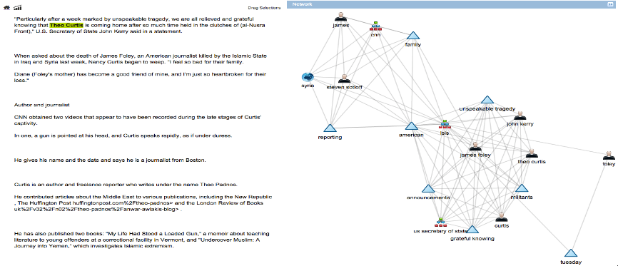
Query Views – Network View

Slide 64
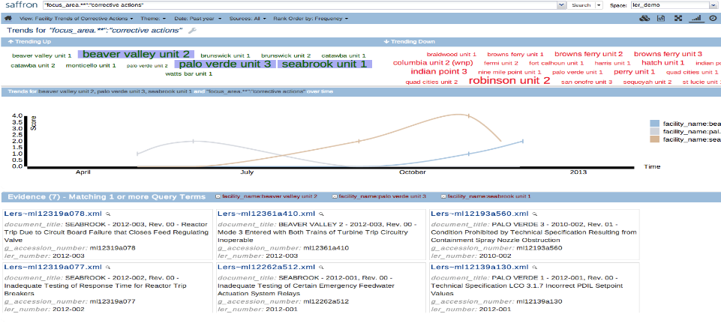
Query Views: Trends View
Trends View: show trending entities associated to the input query.
Change calculation to frequency or correlation
Trending down entities
Trending up entities
Click to show trend line; Multi-select to compare
Select data point to narrow down evidence and display heat map explanation

Slide 65
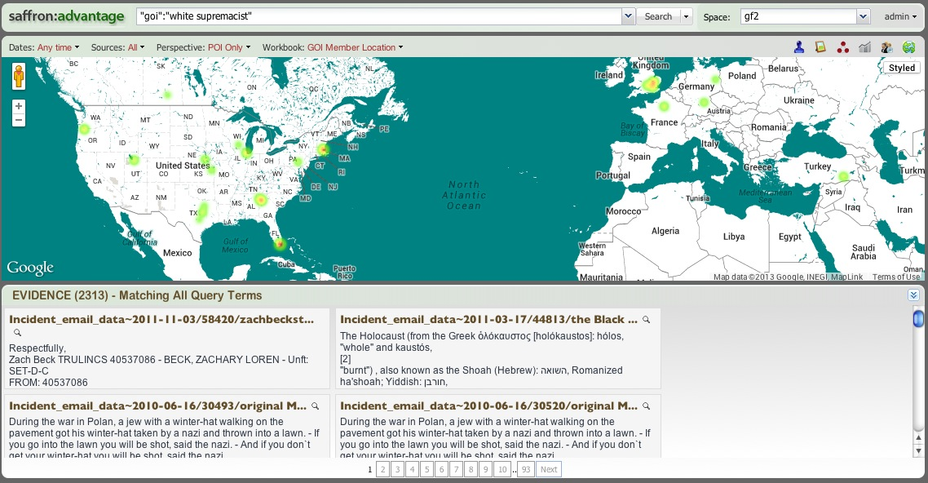
Query Views – Map View

Slide 66
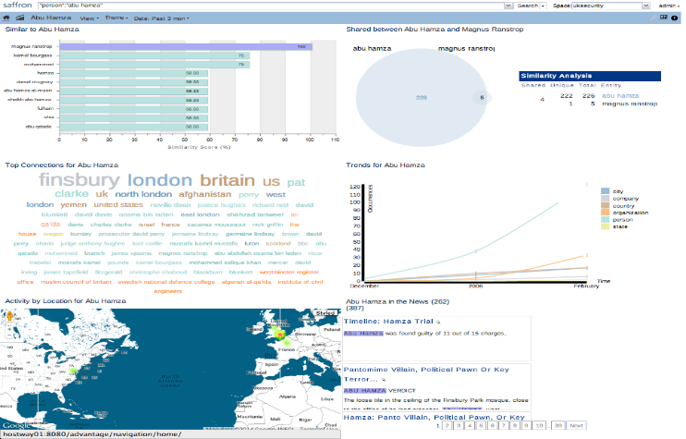
Entity Profile

Slide 67
THOUGHT PROCESSES

Slide 68
Definition
Any Programmatic Combination of:
SMB REST Calls
Data Manipulation
Result Delivery
Languages (Most Common)
Python
Java
Javascript
Bash Script

Slide 69
COMMON USAGE Patterns
Data Traversal
Collecting Scores/Metrics
Clustering
Identifying Information Significance
Collecting Raw Counts
Design Custom Calculations
Quick Lookup

Slide 70
HELP

Slide 71
Where to go for Help:
Online documentation:
Docs.saffrontech.com
Saffron Advantage User Guide: https://saffrontech.atlassian.net/wiki/display/DOC/Saffron+Advantage+User+Guide+9.0
Saffron Admin User Guide: https://saffrontech.atlassian.net/wiki/display/DOC/Saffron+Admin+User+Guide
API Documentation: https://saffrontech.atlassian.net/wiki/display/DOC/REST+API
THOP Documentation: https://saffrontech.atlassian.net/wiki/display/DOC/Thought+Processes
Questions: https://soco.intel.com/groups/saffron-community-of-practice
“Sightings”: https://jira01.devtools.intel.com/browse/SPIP

Slide 72
Thank you
Cameron Byrd
Atul Borkar

